Slide 1


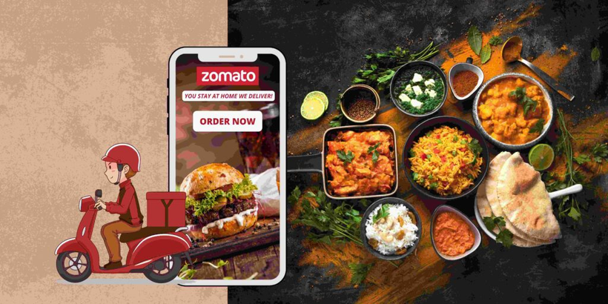
Zomato Data Analysis
Presented by PRASHANT SHARMA

Slide 2

About Zomato
It is a Indian multinational food delivery company and restaurant aggregator was founded in 2008 by Deepinder Goyal and Pankaj Chaddah.
Zomato offers information, menus, and reviews of restaurants, as well as food delivery options from partner restaurants.
Zomato also provides an online restaurant discovery guide with information on dining out, home delivery, nightlife, and cafes.

Slide 3
Problem Statement
Zomato team is looking for business expansion and want to open new restaurants.
Key focus areas:
Analyzing total restaurants that are currently in business. Country-wise restaurant distribution.
Ratings and votes distribution to get an understanding of customer feedback and preferences
Availability of effective and quick help through online delivery and table booking options.
Key metrics:
Restaurant ID: Unique identifier for each restaurant.
Restaurant Name: The name of the restaurant.
Cuisines: The type of cuisine offered by the restaurant.
Has_Table_booking: Indicates whether the restaurant has a table booking option (Yes/No).
Has_Online_delivery: Indicates whether the restaurant offers online delivery (Yes/No).
Price_range: A numeric value indicating the price range category of the restaurant.
Votes: The number of votes or ratings/(feedback) received by the restaurant.
Average_Cost_for_two: The average cost for two people dining at the restaurant.
Rating: The overall rating of the restaurant is based on user reviews.
Datekey_opening: The date when the restaurant was opened.

Slide 4
Analysis Approach
Data cleaning
Used functions like COUNTBLANK() to check for missing values in all columns, removed the missing values from cuisines column.
VLOOKUP(), LEFT(), MID()+FIND() were used to insert relevant data such as Country names, Year, Currency formatting.
Pivot tables were inserted for quick summarization of required metrics and identify patterns in the data.
Data was filtered and sorted and corelated with different metrics like ratings, average cost for two, etc. to identify trends and behavior patterns of the data.
Charts and slicers were created and added to a dashboard to provide a concise representation of the data and help guide the discussion of new restaurants.

Slide 5



Overview
Total Number of Restaurants: 9542
Total Countries : 15
Global Average Ratings: 2.9
India has the highest number of restaurants with 8652 restaurants followed by United States of America with 425 restaurants.

Slide 6

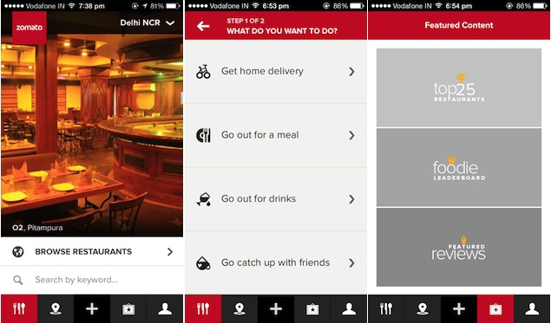
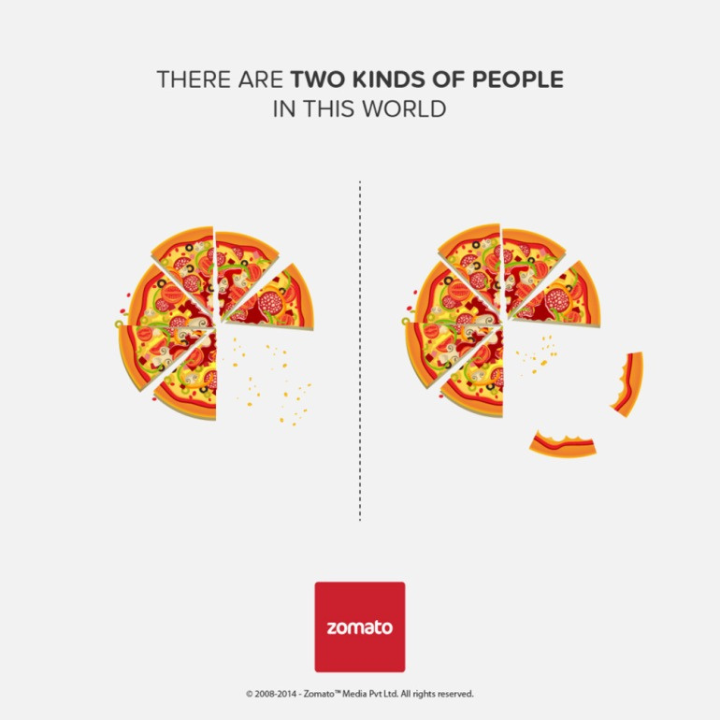
Data Overview and Cleaning
Data Overview
There are total 9551 restaurants in the world wide.
Most number of the restaurants were opened in year 2018.
We can see most of the restaurants have online deliveries and table bookings both.
Restaurants have price range between 1- 4.
Different restaurants has different ratings based on their cities cuisines and price range.
Data Cleaning
There are null values present in columns Longitude, Latitude and votes are replaced by their average respectively.
There are 9 blank cells found in the column cuisines are replaced by cuisines based on their country codes.
All currencies are updated in the Indian Rupees in the new column created named as currency Updated.
Year is extract from the column Datekey_Opening.
Data is well maintained with help of wrap text, borders and Bold functions.

Slide 7
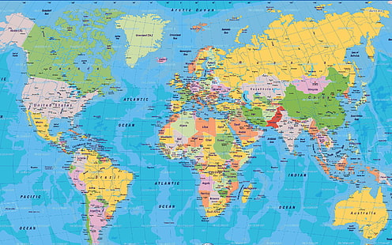
Country selection for opening new restaurant
Canada - based on the number of restaurants were already presents there were 4 and having average ratings of more than 3.5
Qatar - based on the number of restaurants were already presents there 20, having average ratings of more than 4 and have more than 163 of average voters.
United states of America - based on the number of restaurants were already presents there were 434 but having average ratings of more than 4, and have more than 428 of average voters and also has online delivery available.

Slide 8
Types of Bookings
The restaurants those which have table bookings are 55% and rest 45% does not have table bookings.
The restaurants those which have online bookings are 54% and rest 46% does not have Online bookings.

Slide 9
Countries Demanded on basis of votes
Indonesia is the only country which crosses the average line of 500 votes and got highest number of average votes defeating all the countries worldwide.
The number of restaurants and their ratings were the key metrics used to determine the best locations for opening new restaurants.
Small number of restaurants would reduce competition and provide a good foundation for new restaurants.
Lower-average ratings would indicate the need for better services and quality.
Canada, Singapore and Sri Lanka are suggested for new restaurant openings.

Slide 10
Top Cuisines
Understanding which cuisines are popular helps in deciding what to offer in new restaurants to match customer preferences.
Globally, North Indian cuisine leads in popularity with the highest number of votes.
Chinese and fast food are also customer favorites.

Slide 11
Price Range Distribution
Price range will also help us understand spending behavior of the market.
Majority of the restaurants fall in the price range of 1-2, which suggests that the customers prefer affordable dining experience.
Offering restaurants that offer a price range between 1-2 will attract a large customer base.
A niche market for price ranges 3-4, which can be explored as the competition is less.

Slide 12
Yearly Restaurant Openings
Looking at the yearly number of restaurant openings helps identify trends and understand when and why growth happened. This would help in planning future expansions in the best conditions.
Analyze peak years to understand factors driving growth and replicate success strategies for future expansions.

Slide 13
Average cost for two (INR)
Checking the average cost for two will help determine the spending behavior of the countries
Among the suggested countries, (Canada, Singapore, and Sri Lanka) the average cost for dining varies significantly, reflecting different market dynamics.
Canada offers a mid-range spending market,
Singapore is suited for high-end dining, and
Sri Lanka is budget conscious.

Slide 14
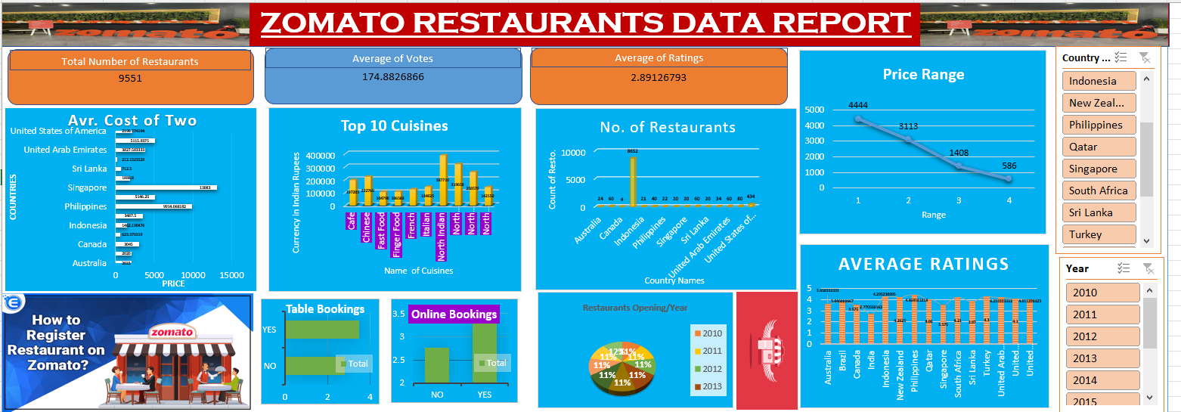
Dashboard

Slide 15
Conclusion
Boost Ratings with Table Booking and Online Delivery
Restaurants with these services have higher ratings and improved customer satisfaction.
Recommended to include these services in all new restaurant openings.
Market Potential in Key Locations
Fewer restaurants mean less competition; lower ratings highlight opportunities to improve quality.
Canada, Singapore, and Sri Lanka are ideal for new restaurant openings.
Spending Behavior
Understanding average cost for two helps tailor pricing strategies
Canada has a mid-range spending market with less competition, while Singapore offers a high-end market opportunity.
Price Range Offerings
Focus on price ranges 1-2 to attract a broader customer base.
Explore niche opportunities in price ranges 3-4 where competition is lower.

Slide 16

Thank you!

